Slide 1
A Dive into Explainable AI and the Emergence of Explanation Engineering
Research paper : A Survey of Explainable AI and Proposal for a Discipline of Explanation Engineering
Notes:
Entered text
What is an Explanation?
In this section we delve into the nature and definition of an explanation within the context of AI. They address the complexity of explaining AI decisions, acknowledging that explanations must be tailored to their audiences.
Defining Explanation: The paper clarifies the ambiguity surrounding terms like “explainability,” “interpretability,” and “transparency.” The authors propose a definition of an explanation in AI as a communicative act that makes the decision-making process of an AI system understandable to a human.
Audience-Centric Explanations: A significant part of this section discusses how the explanation needs vary based on the audience. Different stakeholders (AI engineers, domain experts, end-users, ethicists, lawmakers, and insurance companies) require different types and levels of explanation.
Factors Influencing Explanations: The paper highlights various factors that influence the creation of an explanation in AI, such as the complexity of the AI model, the nature of the task, and the context in which the AI operates.
Examples for Different Audiences: The authors provide examples of explanations tailored to different audiences, illustrating how the complexity and focus of explanations change depending on who is receiving them.
Explainable AI Techniques?
Taxonomy of XAI Methods: The paper introduces a classification system for XAI methods. This taxonomy differentiates between:
Model-Specific vs. Model-Agnostic Techniques: Model-specific techniques are tailored to specific types of AI models, while model-agnostic techniques can be applied to any AI model.
Global vs. Local Explanations: Global explanations provide insight into the overall decision-making process of the AI system, whereas local explanations focus on individual decisions or instances.
Examples of XAI Techniques: The authors provide examples of various XAI techniques, such as LIME (Local Interpretable Model-agnostic Explanations), SHAP (SHapley Additive exPlanations), and decision trees for global explanations. Each technique’s application context, strengths, and weaknesses are discussed.
Strengths and Limitations: The paper critically examines the strengths and weaknesses of these techniques. For instance, while LIME provides detailed insights for individual predictions, it may not always offer a complete understanding of the overall model behavior.

Slide 2
Table of contents
01
02
03
04
05
06
Introduction
What is an Explanation in AI?
Techniques of Explainable AI
XAI in Different Domains
Explanation Engineering
Conclusion

Slide 3

01
Introduction

Slide 4
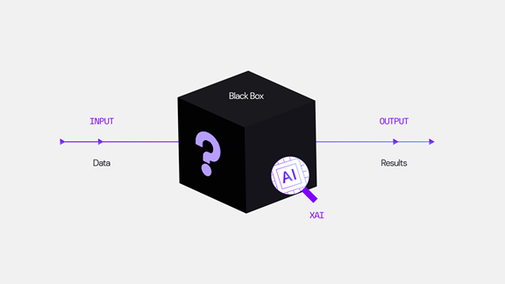
Introduction to Explainable AI
In an era where artificial intelligence (AI) is increasingly tasked with critical decisions, the demand for transparency has never been higher. Explainable AI (XAI) is our answer to unmasking the “black box” of AI processes.
Explanation in AI means — it’s about making the functioning of AI systems clear or easy to understand for various audiences.

Slide 5
Need For XAI
The research paper on Explainable AI (XAI) delves into the critical importance of making artificial intelligence systems not only effective but also understandable. As AI technology becomes increasingly integrated into various sectors, from healthcare to autonomous vehicles, the decision-making processes of these AI systems have grown complex and often opaque. This complexity poses a challenge, as traditional methods like code inspection and logic understanding are inadequate for ensuring transparency in sophisticated AI models, particularly those using complex algorithms like deep neural networks.
XAI emerges as a crucial concept in this context. It's about ensuring AI operations and outcomes are comprehensible to humans, a key aspect for building trust, promoting ethical usage, and aligning AI with societal norms. Further it highlights that explainability isn't a one-size-fits-all approach; it varies greatly depending on the AI application and its stakeholders. For instance, the explanations needed for AI in medical diagnostics are vastly different from those in financial forecasting.
Clear explanations are vital for identifying and fixing errors in AI systems, and for improving their performance. As AI systems become more integrated into critical areas, the paper introduces the idea of "Explanation Engineering" – designing AI systems with explainability as a core component from the outset, ensuring transparency and trustworthiness.

Slide 6
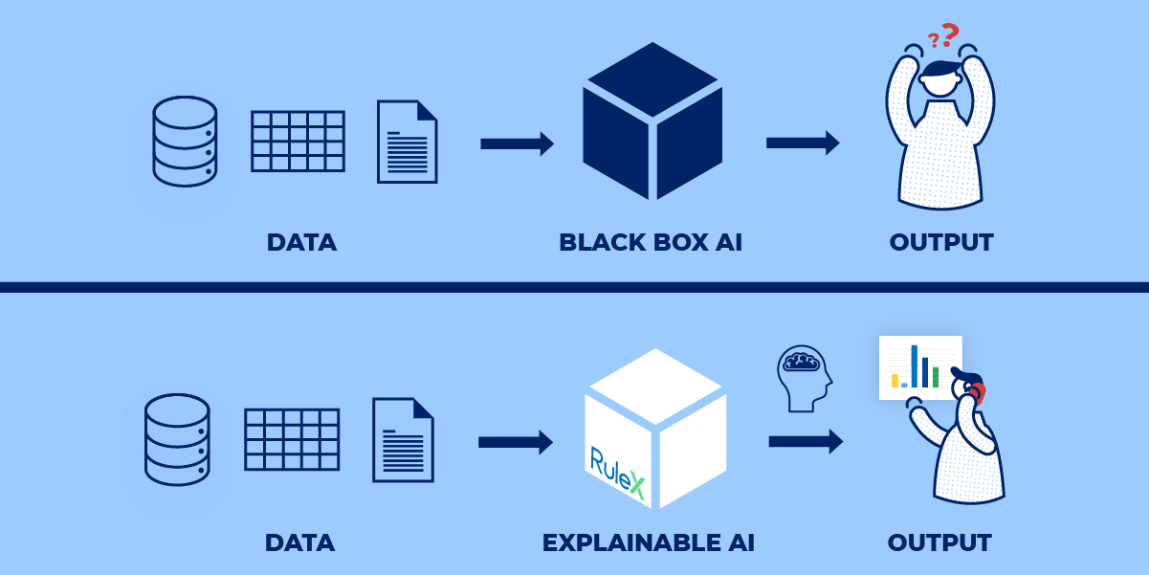

Slide 7
02
What is XAI?

Slide 8
What is Explanation
"What is an Explanation?" in AI, it's really about how we make AI decisions clear and understandable for everyone. It's not enough for an AI system to just be transparent – it's about making sure that anyone, regardless of their technical background, can grasp why an AI system acts a certain way.
Think about it like this: different people need different kinds of explanations. An AI developer might need a very technical, detailed breakdown, but someone like a doctor using AI for patient care might need something more straightforward and applicable to their work. It's fascinating because it means that explaining AI isn't a one-size-fits-all task – it's more tailored and personal.
For me, this idea is really important. As AI becomes more integrated into all kinds of fields, it's essential that its decisions aren't just a mystery to those who don't have a tech background. We need to ensure that explanations are user-friendly and relevant to the audience. This approach doesn't just demystify AI, but it makes it more accessible and trustworthy, something that's increasingly important as AI continues to grow in our lives.

Slide 9
03
Techniques of Explainable AI

Slide 10
Taxonomy of XAI Concepts
Global vs. Local Explanation Techniques
Global Interpretability: Understanding the overall working of an AI model.
Local Interpretability: Focusing on explaining individual predictions.
Example: In medical imaging, local interpretability might involve identifying specific features in an image that led to a particular classification.

Slide 11
Diverse Techniques in Explainable AI
Model-Specific Techniques:
Model-Agnostic Techniques:
Tailored to a single model or a group of models.
Relies on the unique architecture and capabilities of the specific model.
Applicable to any machine learning model.
Works by analyzing input features and output pairs.
Example: Explanation of a classification task using LIME (Local Interpretable Model-Agnostic Explanations) for YouTube comments.

Slide 12
XAI methods
Example-Based Explanations: Models like kNN utilize comparisons with instances from the training distribution to explain predictions. Prototypes, criticisms, and comparisons communicate model logic.
Local Interpretable Model-Agnostic Explanations (LIME): LIME approximates complex models via local sparse linear models to identify salient input regions and their contributions to predictions. Model-agnostic and faithful explanations make LIME popular.
Shapley Values: This game-theoretic approach assigns payouts to features of a model to indicate their contribution to outputs. Computational expenses scale exponentially but integration into model pipelines enable responsiveness.
Simpler Models: Linear models and decision trees have an inherent level of transparency and global interpretability due to more intuitive mechanisms and feature weighting. But performance lags behind complex models.

Slide 13
04
XAI in Different Domains

Slide 14
XAI Applications
As discussed earlier, aspects like audience types, risk tolerances, performance constraints, and regulatory requirements create complex demands on XAI solutions. Their objectives, scope, and evaluation criteria vary. Explanations adequate in one domain may be deficient in another.
Domain-Specific XAI Needs: The paper highlights that different domains have varying needs and challenges when it comes to explainability. This variation is influenced by factors like the complexity of the domain, the stakes involved in decision-making, and the level of expertise of the end-users.

Slide 15
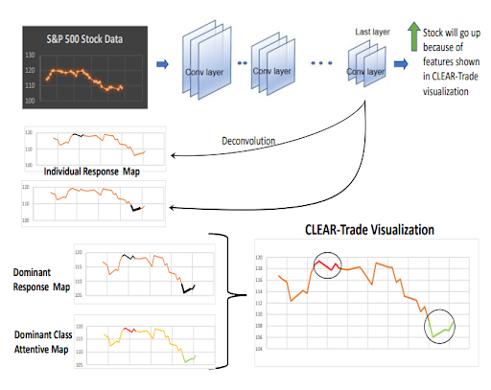
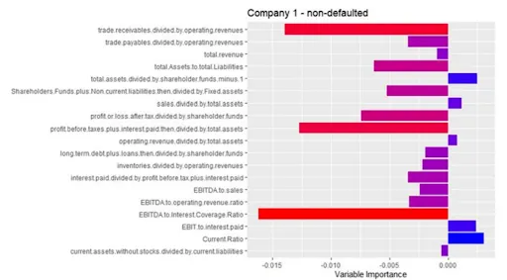
Finance
In finance, XAI is crucial for risk assessment, fraud detection, and explaining credit decisions. Here, regulatory compliance and customer trust play significant roles.
Trust building to convince investors and robustness against unfair outcomes are key goals. Both model logic and training data require examination.
Explaining specific cases of credit default using prototypes shows promise. Heatmaps clarify stock market predictions but omit external drivers.

Slide 16
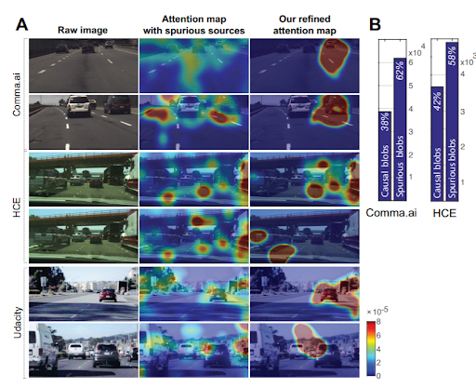
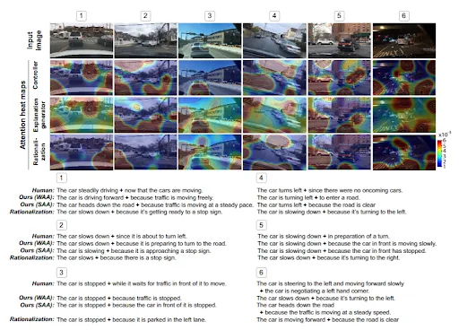
Autonomous Driving:
Explainability in autonomous vehicles is vital for understanding vehicle decisions in real-time, which is crucial for safety and legal reasons.
Explanations help operators intervene if needed and aid regulators in accountability assessments after accidents.
Attention techniques identify failure points but lack reasoning details expected by engineers. Natural language augmentations show promise.

Slide 17
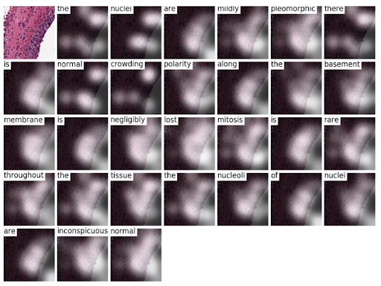
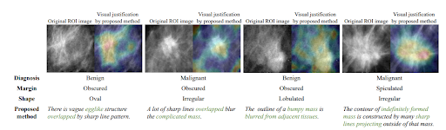
Healthcare
In healthcare, XAI assists in diagnostic processes, treatment recommendations, and patient data analysis. The emphasis is on accuracy, reliability, and the ability to provide explanations that healthcare professionals can trust.
Explanations help doctors calibrate trust and reconcile disagreements. Patient-facing education also matters. Domain constraints limit techniques.
Pathology annotations clarify MRI scan classifier decisions for experts better than occlusion masks which have perceptual issues.

Slide 18
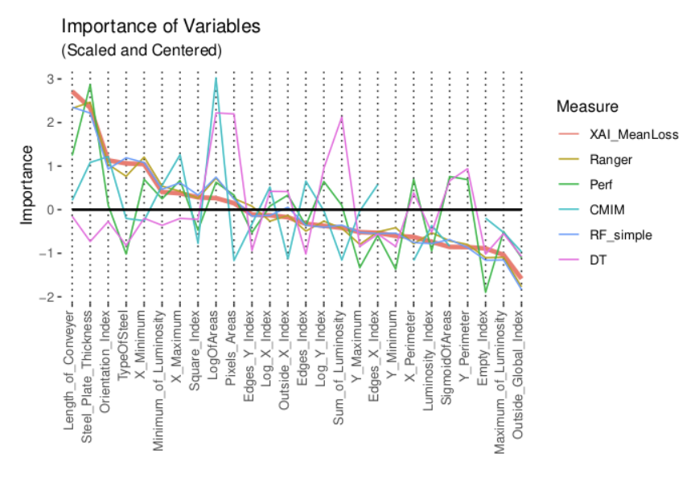
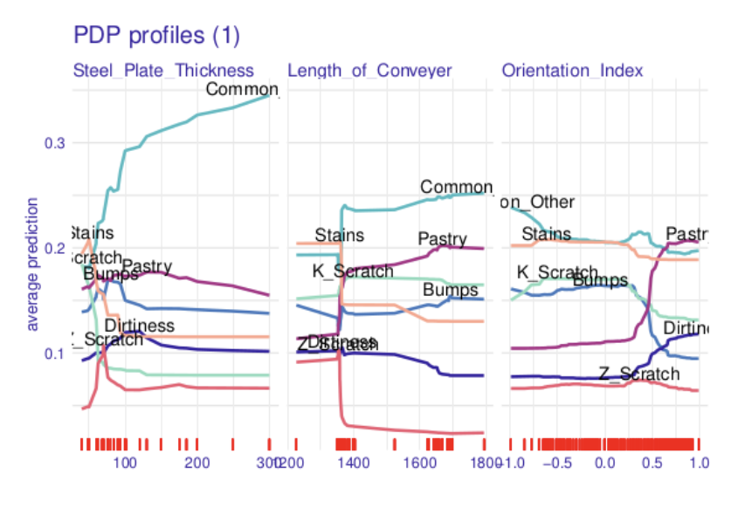
Manufacturing
In the manufacturing sector, XAI is applied in predictive maintenance, quality control, and process optimization. Explanations are valuable for improving operational efficiency and decision-making.
Explanations aid monitoring and redundancy rather than direct consumer value. Estimating production impact is the focal point.
Ablative measures quantify feature contributions well but assume modularity may not hold due to unmodelled constraints.

Slide 19
05
Explanation Engineering

Slide 20
Definition and Need: Explanation Engineering is defined as the discipline that deals with the systematic integration of explainability in AI systems. The authors argue that as AI systems become more complex and ubiquitous, the need for a structured approach to explainability becomes more critical.
Framework for Explanation Engineering: The paper proposes a framework that includes guidelines and best practices for designing explainable AI systems. This framework emphasizes the importance of considering explainability at every stage of the AI development process, from conception to deployment.
Collaboration Across Disciplines: The authors highlight the need for collaboration between AI developers, domain experts, and end-users to ensure that explanations are meaningful and useful. This interdisciplinary approach is crucial for developing effective and context-sensitive explanations.
Challenges and Opportunities: While recognizing the challenges in establishing a new discipline, the paper also discusses the potential benefits. These include improved AI system reliability, increased user trust, and facilitation of regulatory compliance.
Explanation Engineering

Slide 21
6-stages of Explanation Engineering
Negotiation
Analysis
Knowledge Extraction
Set explainability goals by identifying target audiences and enumerating metrics to grade system transparency along dimensions like trust, causality, and accessibility. Analyze tradeoffs with model performance goals.
Prioritize audiences and reconcile conflicts between competing explanatory objectives. Settling on explanation sufficiency levels prevents over-engineering.
Determine appropriate techniques to extract salient knowledge from the model and data to form explanations. Examine fidelity and performance costs.
Evaluation
Interface Design
Explanation Formulation
Devise interaction modalities around explanations sensitive to human factors. Enable personalization and refinements through user feedback
Operationalize metrics identified during analysis to grade utility of explanations. Confirm if user requirements are fulfilled or gather feedback for design improvements.
Select representations like text, visuals, prototypes etc. appropriate for each audience while condensing extracted knowledge into explanations.

Slide 22
06
Conclusion

Slide 23
This paper provides a comprehensive overview of the growing field of explainable AI (XAI). As AI systems are increasingly deployed in real-world settings, explanations to users regarding their logic and predictions becomes imperative for trust and accountability. The authors survey various techniques for XAI that balance tradeoffs like accuracy and interpretability, highlight domain-specific applications, and propose the novel framework of Explanation Engineering to embed explainability objectives throughout the machine learning pipeline. While further enhancements around subjectivity and verification remain, the paper sets the stage for more deliberate, user-centric design of interpretable AI systems via its structured methodology.
Conclusion

Slide 24
Thanks!
Do you have any questions?
aagamshah0812@gmail.com

